Slide 1

OCCT2254
Case Study
A Community Health Center

Slide 2
Step One: Request for Service - Framing
Adult Community Occupational Therapist
To assess the functional ability of clients living in their home or other environments
Determine appropriate recommendations for necessary equipment or modifications
Determine any needed referral to other service providers
(Ezijob, 2005)

Slide 3
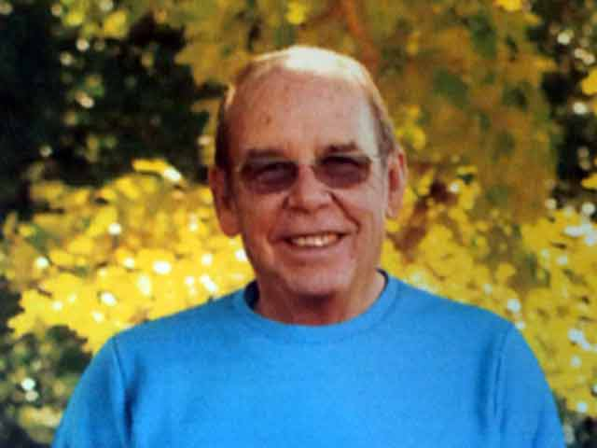
Case Profile:
68 year old male, Mr Welsh (pseudonym)
Diagnosed with motor neurone disease (MND) in 2012
Owns a small trucking and farming business
Previous medical history
Osteoarthritis
Deformed coccyx
Chronic obstructive pulmonary disease
Bilateral ligament damage in hands

Slide 4
Referral Process:
Can be made to the community Occupational Therapist (OT) by health professionals or clients/their families
A priority tool is then completed
Determines how urgently a client should be seen
Standardised approach so clients can be rated fairly

Slide 5
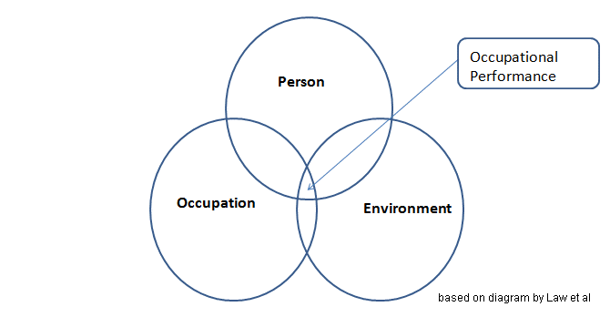
Step Two: Information gathering - focusing
Person, environment, occupation (PEO model)
Looks at the environment as a major factor in successful and satisfying occupational performance
Mr Welsh’s environment is limiting his occupation performance
(Law, Cooper, Strong, Stewart, Rigby & Letts, 1996))
(Dunn, Brown & McGuigan, 1994)
(Brown, 2009)

Slide 6
Step Two: Information Gathering:
PEO MODEL:
Person | - Contacted MND NSW Information on symptoms and functional implications Muscle weakness, fatigue, loss of range of movement (ROM)
Environment | - Home Facility Risk Assessment (Appendix C)
Occupation | - Can have an idea of what occupations may be affects - Will gather more info on occupation during assessment phase of treatment
(MND NSW, 2012)

Slide 7
Step Three: Occupational Assessment
Occupational Therapy Home Assessment Report:
provides the therapist with detail about the client’s values and interests and view of their occupational performance
client’s physical environment is assessed as the client takes the therapist around the house and demonstrating their functional ability
ensures the home environment is safe and that maximal independence can be obtained here for the client.
(Cumming, R. G., Thomas, M., Szonyi, G., Salkeld, G., O’Neill, E., Westbury, C., & Frampton, G, 1999)
(Chui, Oliver, Marshall & Letts, 2001)

Slide 8
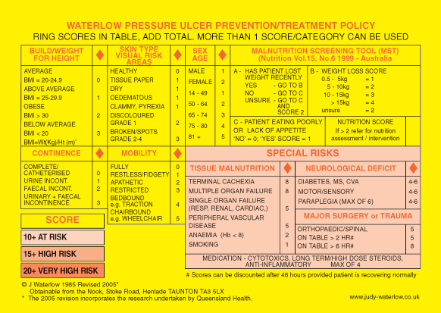
Waterlow Pressure Ulcer Risk Assessment:
Used to assess how high risk of developing pressure ulcers is
(Ayello & Braden, 2002)

Slide 9
Step Four – Identification of Occupational Issues
Occupational issues were identified throughout the home visit assessment and a functional problems list was developed (American Occupational Therapy Association, 2002)
Mr Welsh is unable to shower independently as he cannot lift his legs and feet high enough to get over the hob in the shower in his bathroom.
Mr Welsh is experiencing difficulty sleeping laying down flat as he finds it hard to breath and experiences pain on his sacral pressure area

Slide 10
Mr Welsh is finding it increasingly difficult to mobilise in bed as he becomes fatigued and short of breath on exertion (SOBOE).
Mr Welsh is unable to sit on his lounge chair for long periods of time without experiencing pain due on his sacral pressure are and not having any pressure relieving equipment

Slide 11
Step Five: Establish Goal
In 3 months, Mr Welsh will have appropriate major bathroom modifications installed by a licensed builder, and as specified by the occupational therapy drawing and specifications, so that he will be able to shower and wash himself independently.
Mr Welsh will be provided with equipment to assist with toilet transfers, bed mobility, lounge chair transfers and pressure relief from the equipment loan pool as soon as possible whilst waiting order of same from MND NSW

Slide 12
Using the Person, Environment and Occupation (PEO) model as a guide allowed goals to be client-
centred and Mr Welsh to be involved throughout the therapeutic process, increasing the change of successful therapy
(Townsend &Polatajko, 2007).

Slide 13
Step Six: Intervention
Biomechanical Frame of Reference:
ensured Mr Welsh’s physical capacity was considered including factors such as movement, muscle strength and endurance
aims to compensate for any experience limitations by modifying environments or providing equipment but still encompassing meaningful occupations and allowing the therapist and client to decide on interventions together
(Parker, 2006)

Slide 14
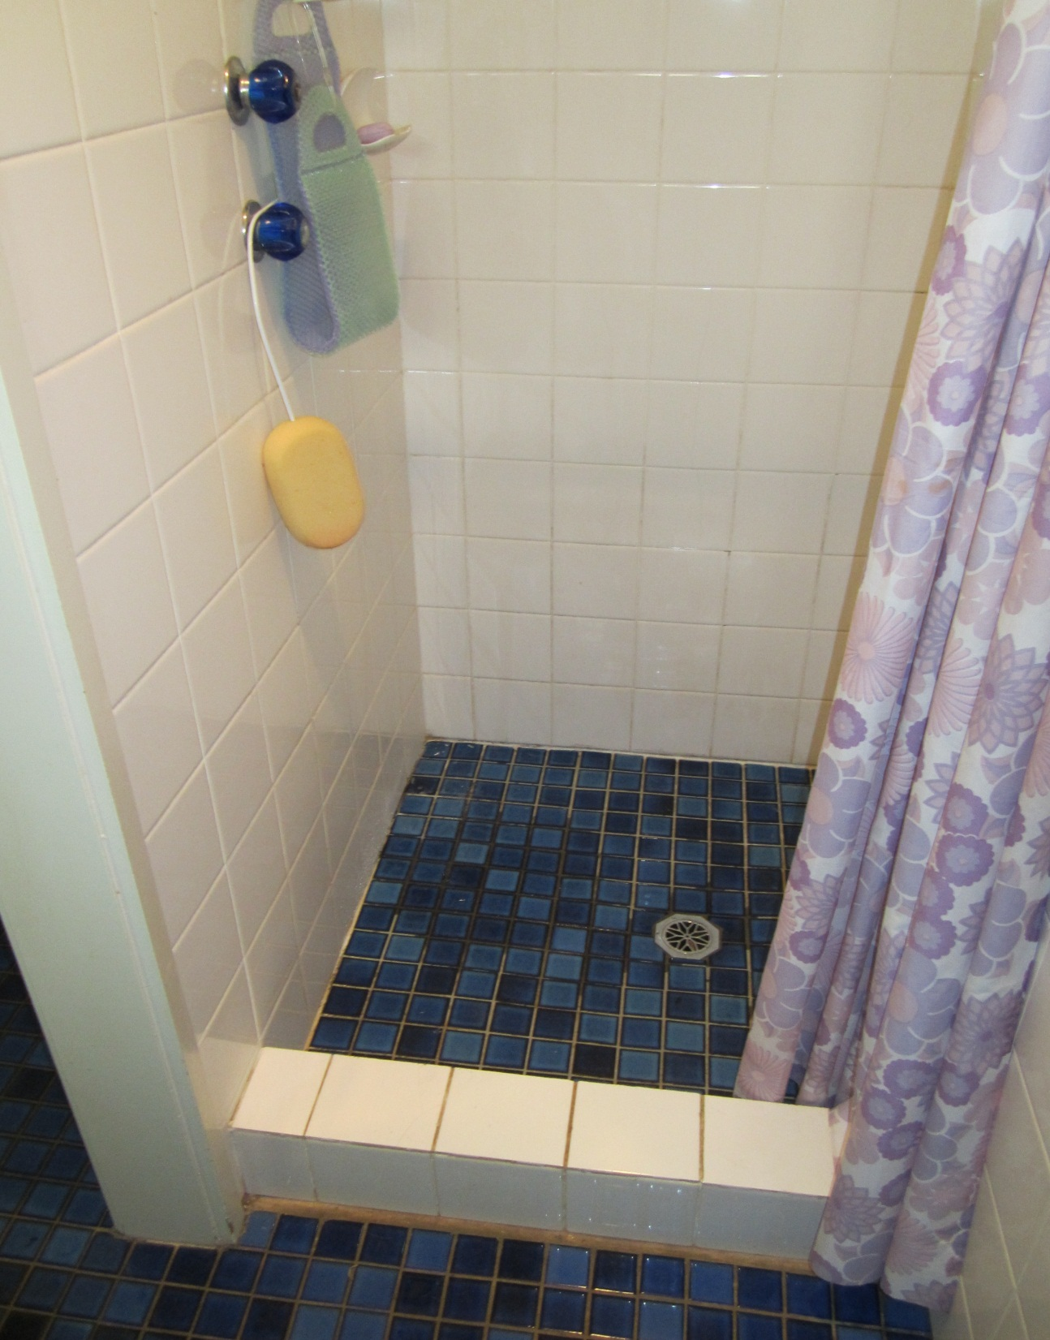

Slide 15
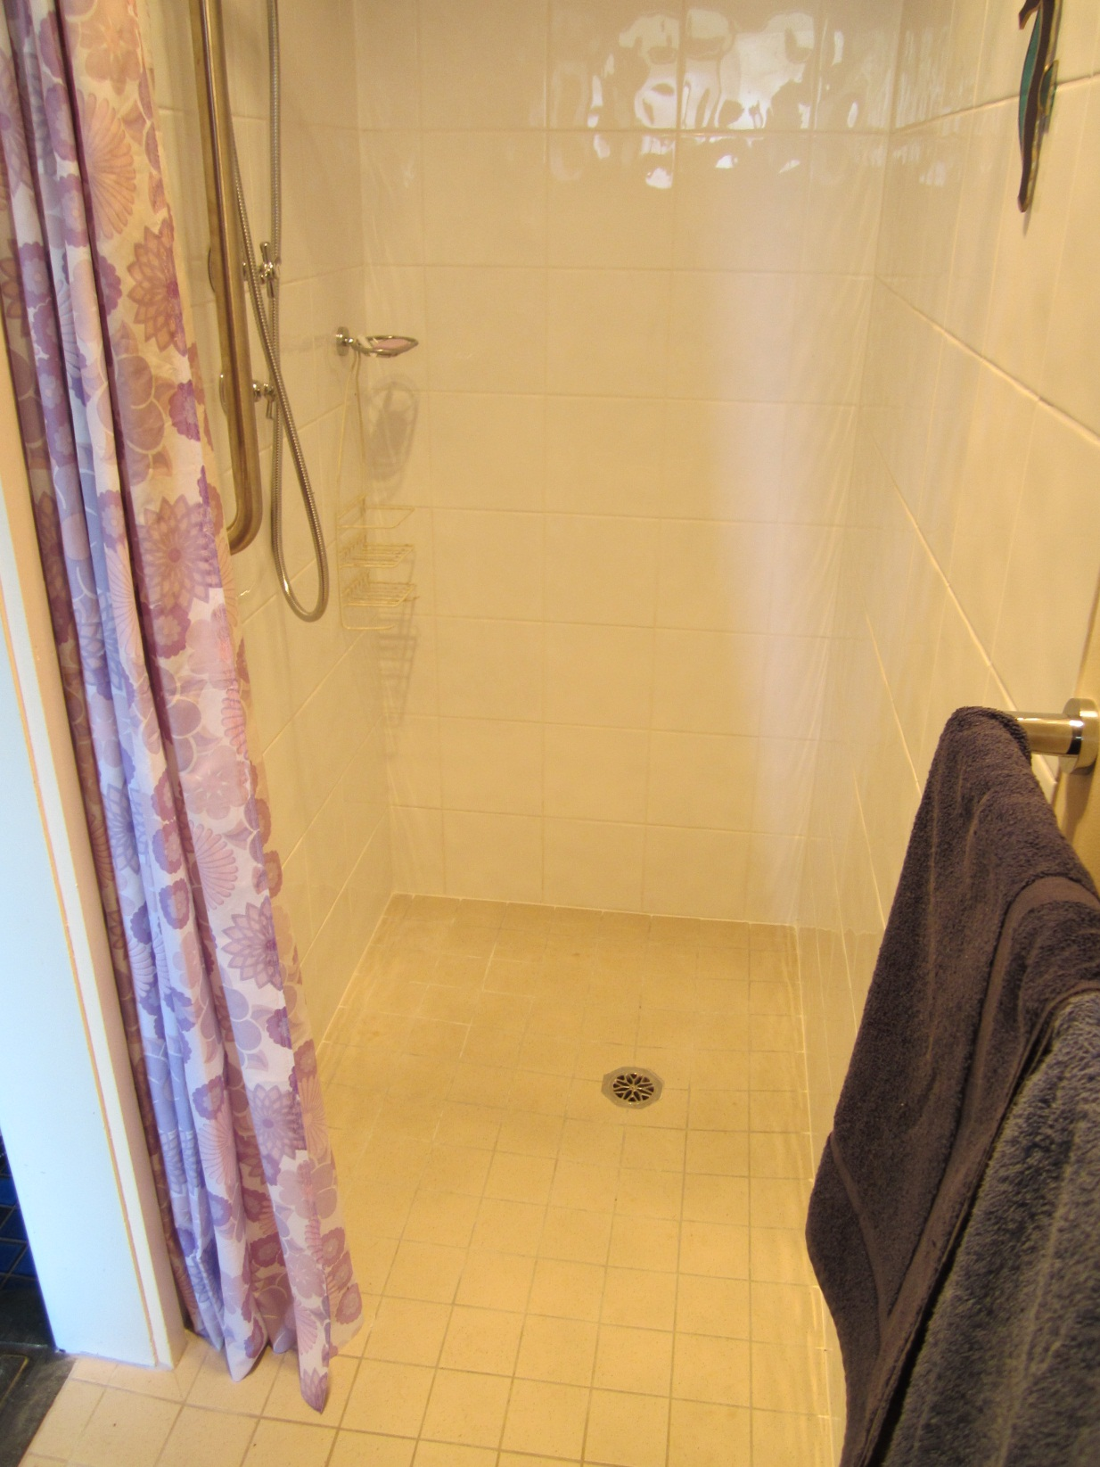
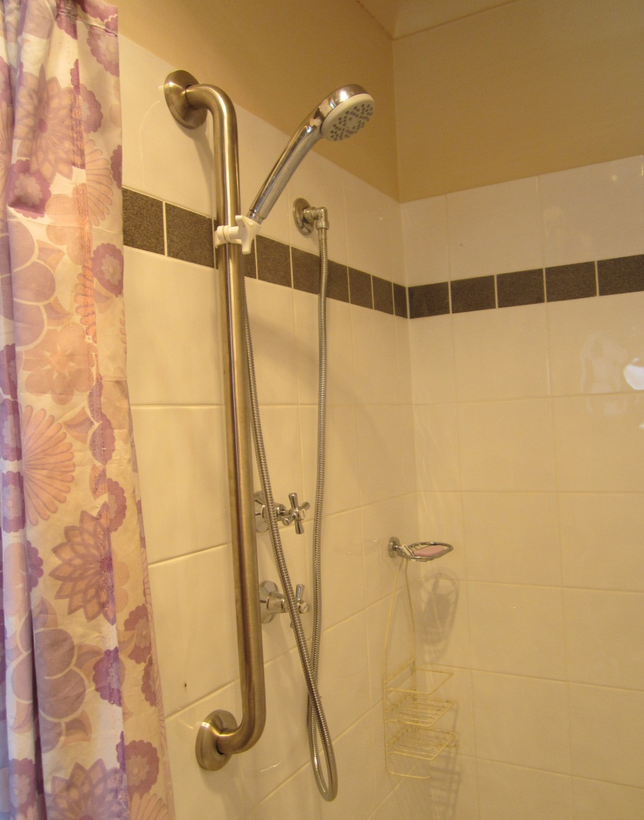
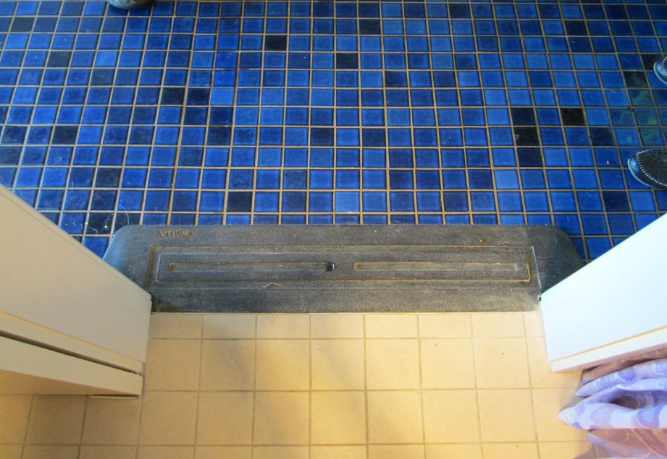

Slide 16
major home modifications have been found to change the home environment to allow individuals to function with maximum independence
This is why it was chosen as suitable for Mr Welsh
provision of equipment would not have been appropriate as MND is a progressive neurological disease so a long term option such as major home modification was needed.
(Law, Cooper, Strong, Stewart, Rigby, & Letts, 1997)

Slide 17
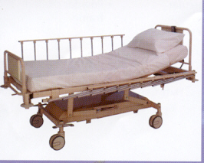
Equipment Prescription
Hi/Low Bed
has controls that allow the bed to move up and down so will assist Mr Welsh to sleep, as he will be able to sitting up and won’t experience breathing difficulties
(Independent Living Centre, 2012)

Slide 18
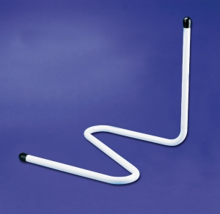
Cobra Bed Stick
for Mr Welsh to use to assist him to mobilise once in bed
(Independent Living Centre, 2012)

Slide 19
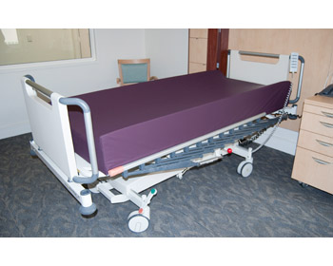
MacMed Pressure Relieving Mattress
this was prescribed for Mr Welsh’s bed to prevent further development of pressure ulcers
have been found to provide immediate pressure redistribution and relief from aching joints
(MacMed Health Care, 2012)

Slide 20
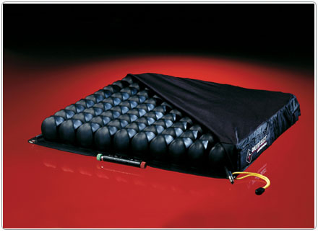
ROHO Cushion
Most effective for high pressure relief
Mr Welsh has no cognitive impairments so will be able to maintain the amount of air kept in the cushion
(The Roho Group, 2012).

Slide 21
Step Seven: Evaluation
The aim of evaluation
to determine if the major bathroom modification and prescribed equipment had enabled Mr Welsh to overcome his occupational issues and achieve his goals to become more independent and safe
carried out via a follow up visit - to ensure modifications met standards in OT drawings and specifications.
Discussion on effectiveness of equipment
(Law, Cooper, Strong, Stewart, Rigby & Letts, 1997)

Slide 22
Reference List:
American Occupational Therapy Association. (2002). Occupational therapy practice framework: domain and process. American Journal of Occupational Therapy, 56, 609-639.
Ayello, E. A., & Braden, B. (2002). How and why to do a pressure ulcer risk assessment. Advances in Skin & Wound Care, 15(3), 125-131.
Baum, C., & Law, M. (1998). Community health: a responsibility, an opportunity, and a fit for occupational therapy. American Journal of Occupational Therapy, 52, 7 – 10.
Brown, C. E. (2009) Ecological models in occupational therapy. In E.B. Crepeau, E. S. Cohn, & B.A.B Schell (Eds.), Willard and Spackman’s occupational therapy (pp. 435-445). Baltimore: Lippincott Williams & Wilkins.
Dunn, W., Brown, C., & McGuigan, A. (1994). The ecology of human performance: a framework for considering the impact of context. American Journal of Occupational Therapy, 48, 595-607.
EziJob. (2005). New england area health – position description. Retrieved October 14, 2012, from https://www.ezisuite.net/eziJob/Standard/ViewJD.cfm?ID=3476&origin=fo&set=1-323

Slide 23
Independent Living Centre. (2012). Assistive technology. Retrieved October 22nd, 2012, from http://ilcaustralia.org.au/Using_Assistive_Technology
Law, M., Cooper, B., Strong, S., Stewart, D., Rigby P., & Letts, L (1996). The person-environment-occupation model: a transactive approach to occupational performance. Canadian Journal of Occupational Therapy, 63, 9-23.
Llewellyn, G., Sullivan, G., & Minichiello, V. (1999). Sampling in Qualitative Research. In V. Minichiello & G. Sullivan & K. Greenwood & R. Axford (Eds.), Handbook for Research Methods in Health Sciences. Frenchs Forest, NSW: Addison Wesley Longman Australia Pty Ltd., 174-199.
MacMed Health Care. (2012). Mattresses. Retrieved October 22nd, 2012, from http://www.macmedhealthcare.com/mattresses

Slide 24
Motor Neurone Disease Australia. (2012). What is MND?. Retrieved October 14, 2012, from http://www.mndaust.asn.au/what-is-mnd/
Parker, D. (2006). The client-centred frame of reference. In E.A.S Duncan (Eds.), Foundations for practice in occupational therapy (pp.203-204), London: Elsevier Churchill Livingstone.
Polatajko, H. J., Townsend, E.a., & Craik, J. (2007). Canadian model of occupational performance and engagement (CMOP-E). In E. A. Townsend & H. J Polatajko (Eds.), Enabling occupation II: Advancing an occupational therapy vision of health, well-being, & justice through occupation (pp. 22-36). Ottawa: CAOT Publications ACE.
The Roho Group. (2012). Frequently asked questions. RetrievedOctober 23rd, 2012, from http://www.therohogroup.com/faq.jsp#20

